Slide 1
Is Behavior Communication?
Understanding What Challenging Behaviors Mean
Brenda Grafton-McCall, PhD, CTRI
Executive Director /Founder - DaDTH

Slide 2
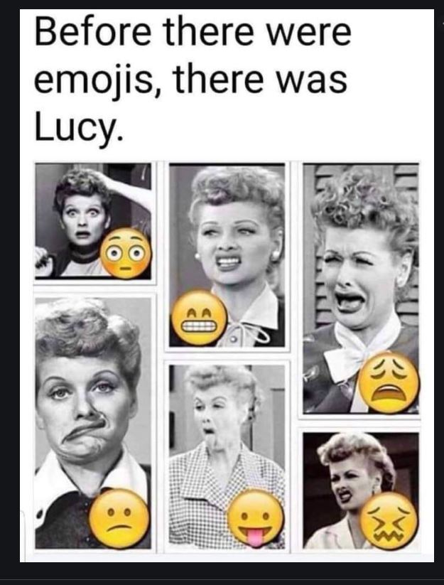
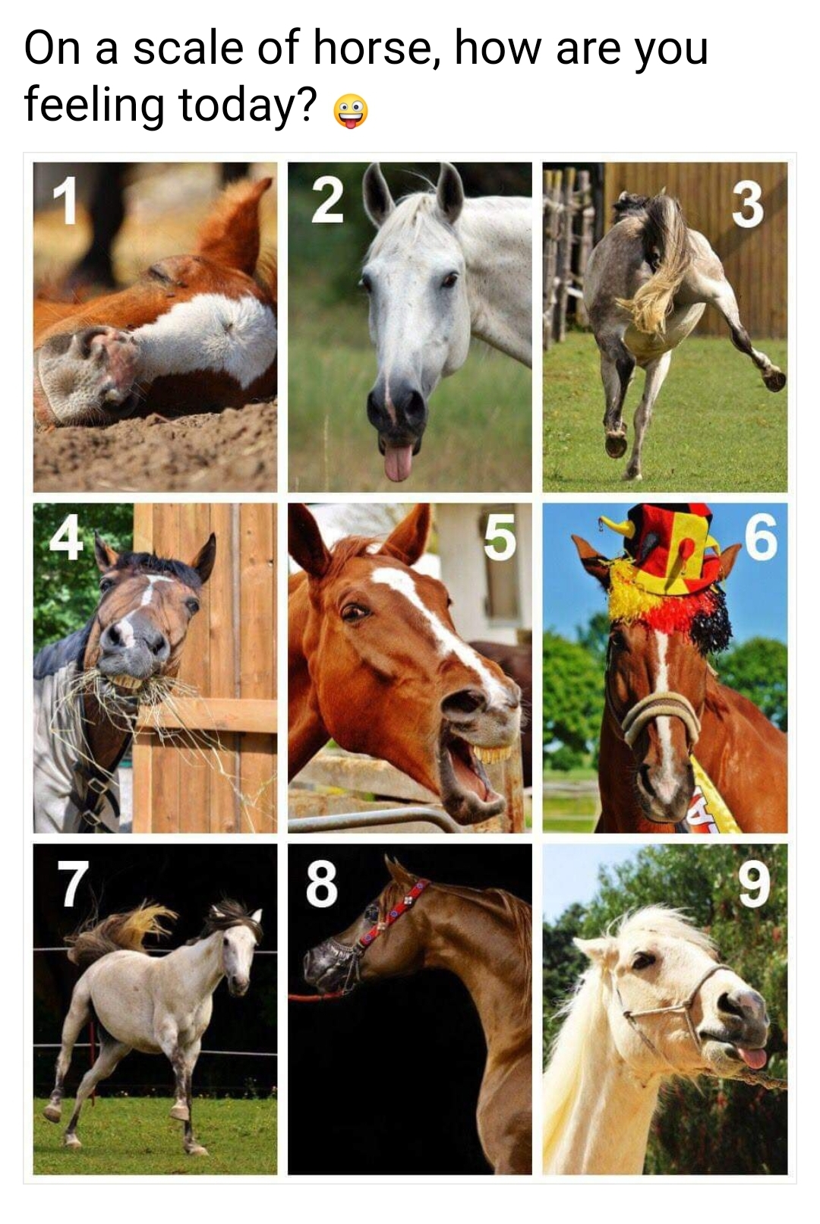

Slide 3
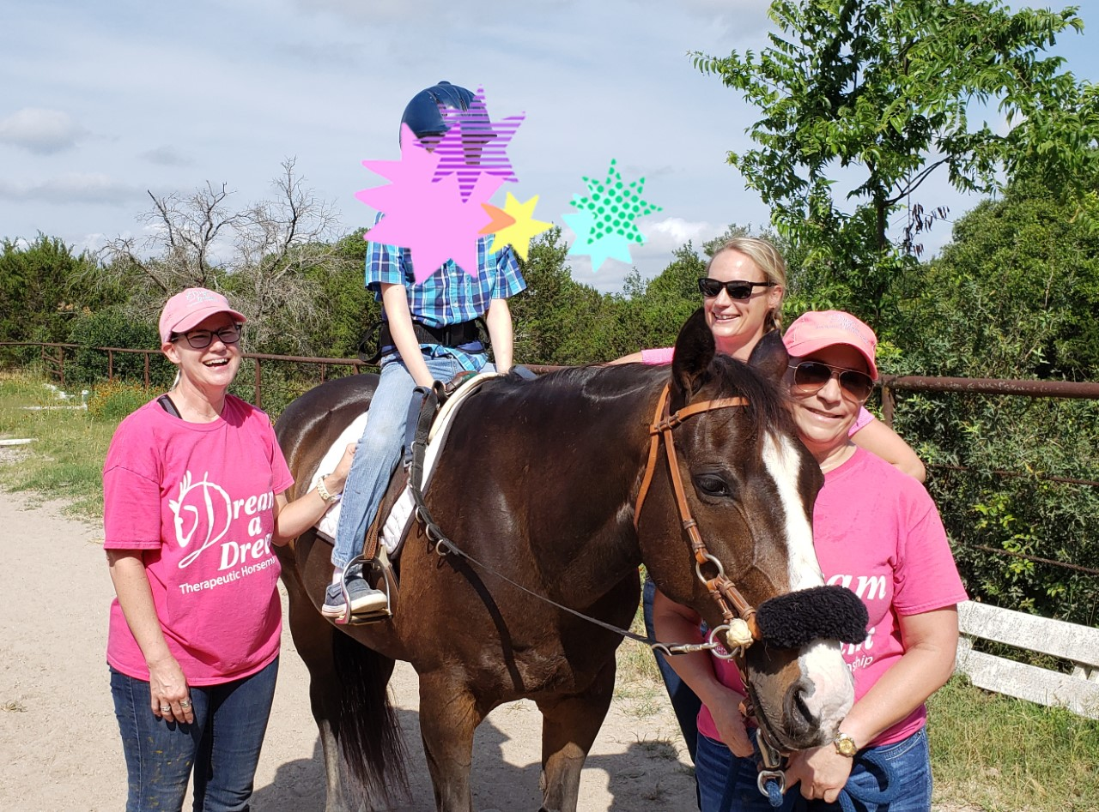
Instructor Vision

Slide 4
The vision changes

Slide 5
Is Behavior Communicating Something?
Is that challenging individual saying something else? What is your initial thought?
Behavior is a form of communication and always has a meaning.
True or False

Slide 6
Understanding behavior as communication
All behavior has a function
Respond to individuals not behavior
What individual’s behavior is telling you
Harness the power of collaboration

Slide 7
Challenging behavior is often described as communicating unmet needs.

Slide 8
5 Motivations for Behavior
William Glasser and The Choice Theory
Survival
Love and Belonging
Power
Freedom
Fun

Slide 9
What Do We All Want in Life?
What WE ALL Want!
What NONE of us Want!
Be accepted
Make choices
Engaged in meaningful activities
Be surrounded by people who care about us
Be listened to and heard by others
Be loved
Be ignored
Thought to be incompetent
Abused
Controlled
Bored
Ridiculed
Manipulated
Disliked

Slide 10
B. F. Skinner – Radical Behaviorism
Private events
Behavior is determined by its consequences
Operant conditioning

Slide 11
3 Term Contingency
Antecedent
Behavior (Response)
Consequence

Slide 12
4 Functions of Behavior
S. E. A. T.
Sensory
Escape/Avoidance
Attention
Tangible Gains

Slide 13
4 Functions of Behavior
Automatic
Socially Mediated
Not mediated by another person
Automatic Positive Reinforcement
self-stimulatory behavior (stim), it feels good.
Automatic Negative Reinforcement
bite hand or hit head because of headache (pain attenuation, SIB, distress)
Occurs because of another person
Socially Mediated Positive Reinforcement
child wants candy, asks nicely, given candy
Socially Mediated Negative Reinforcement
bites hand when he doesn’t want to do something, to get out of something.

Slide 14
Respond to Individuals, Not Their Behaviors
Don’t take behaviors personally
Develop relationships with individuals
Understand life experiences individuals bring to your center
Trauma

Slide 15
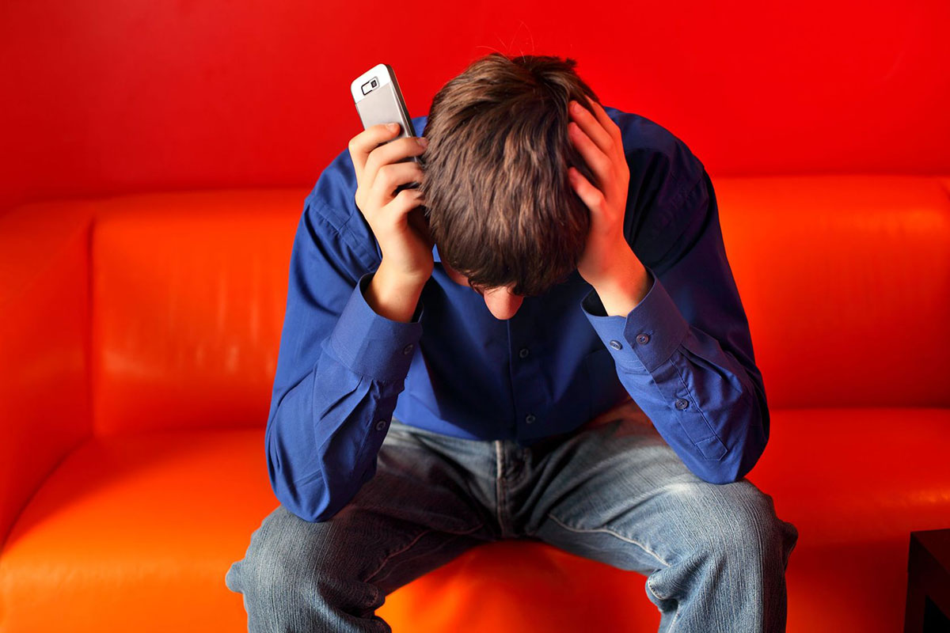
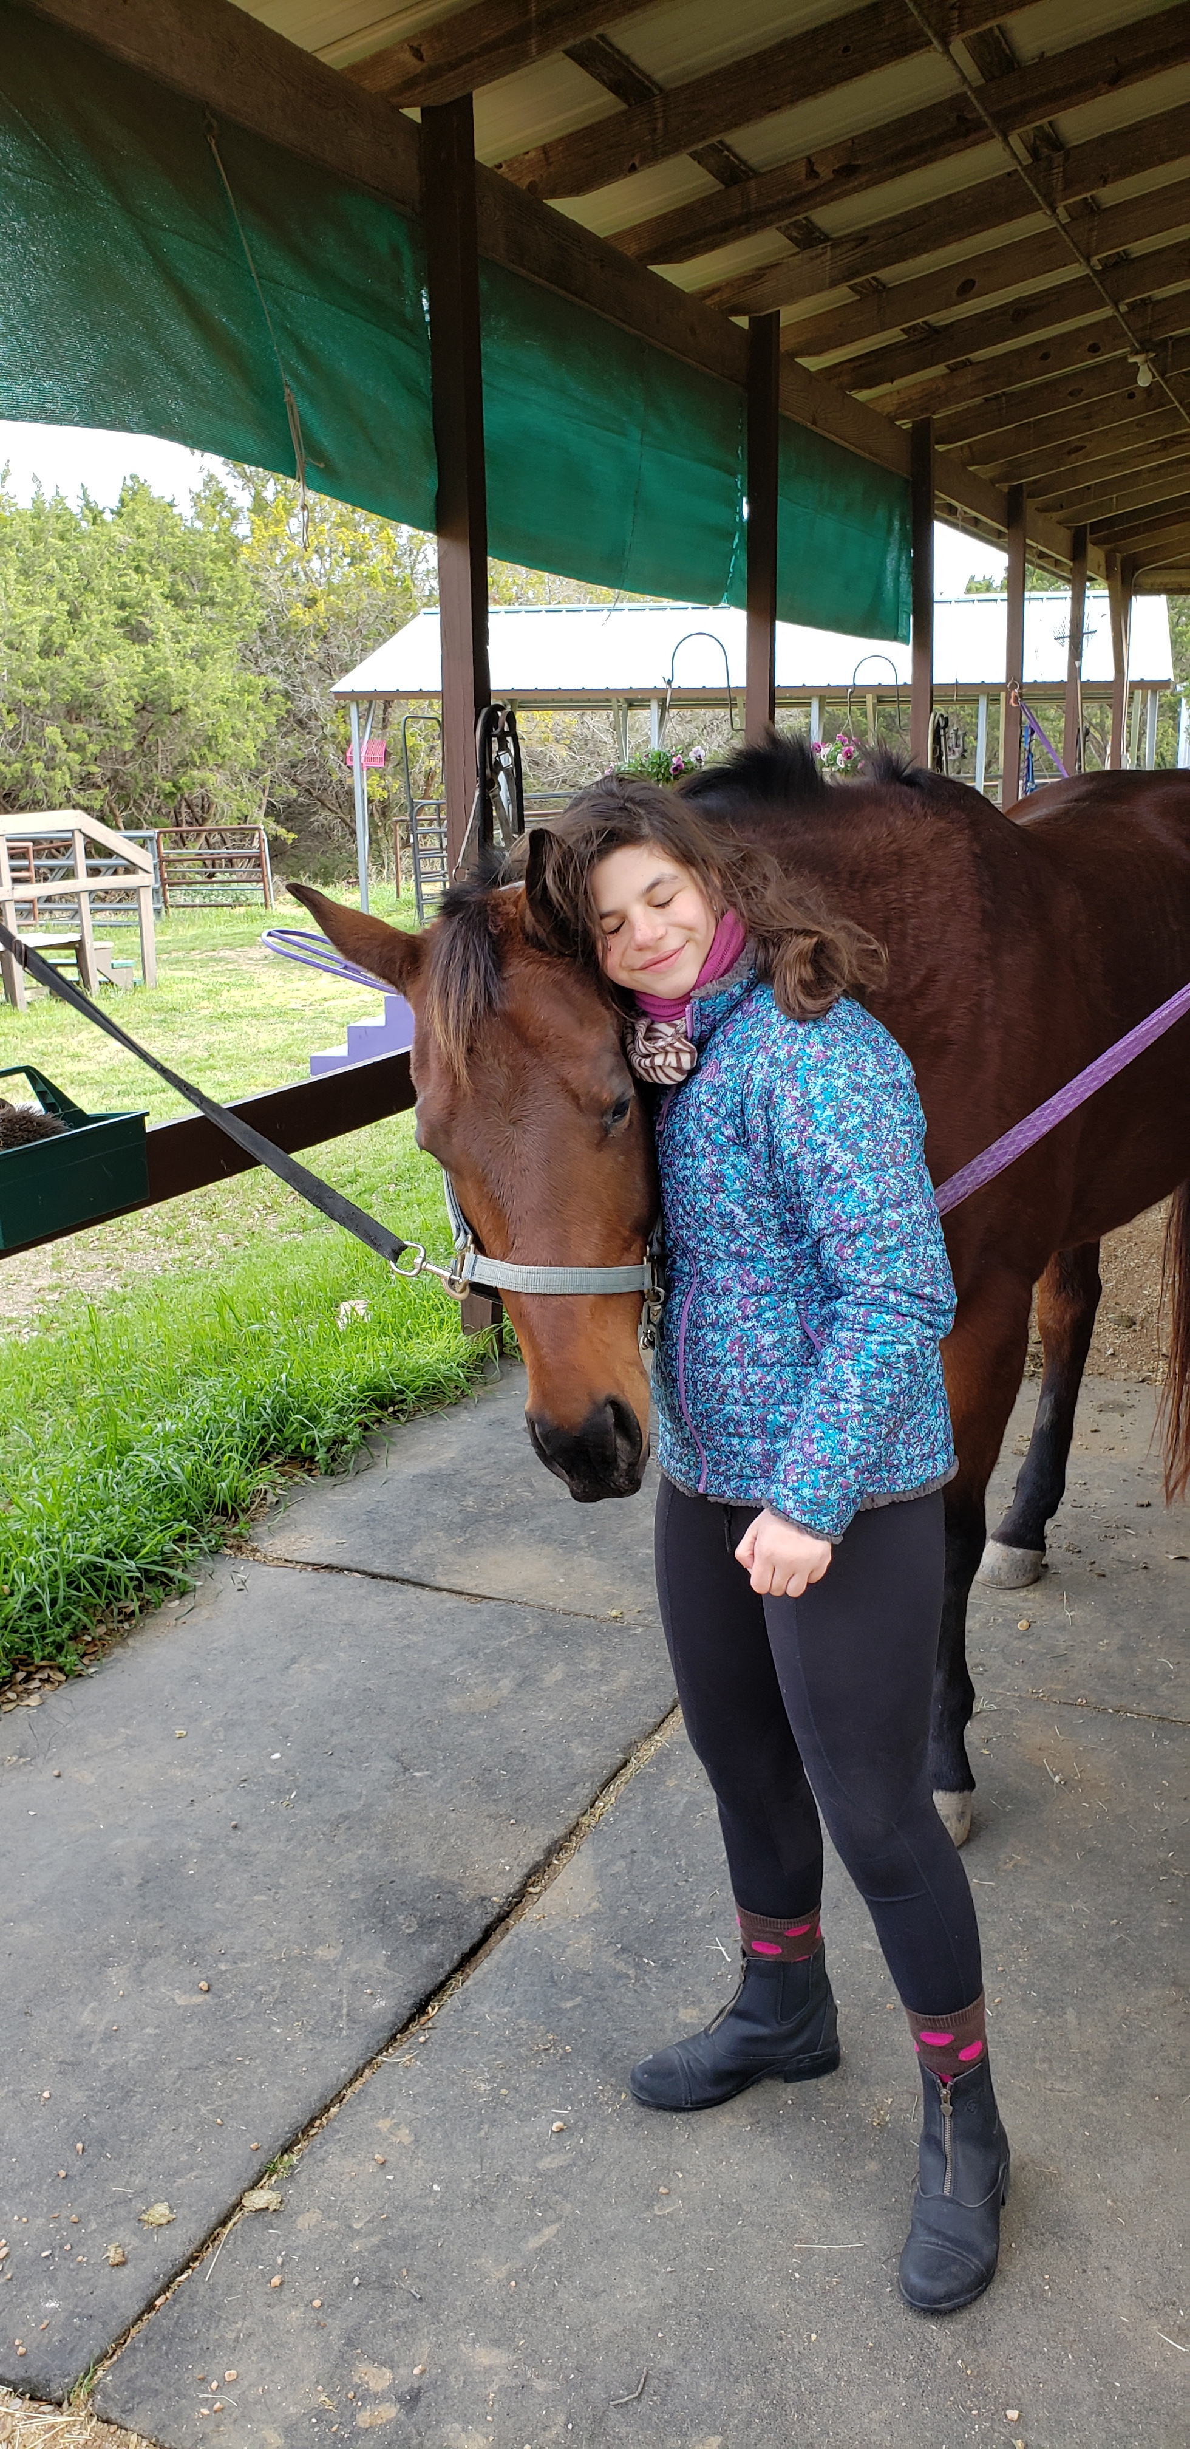
What An Individual’s Behavior is Telling You!

Slide 17
Harness the Power of Collaboration
Parent / Family Members
Care Giver
Teacher / School / BIP
Behavior Therapist / BCBA

Slide 18
When the “why” of a behavior is understood, positive behavior supports can be initiated to decrease challenging behavior. Behavior is communication!

Slide 19
Questions?

Slide 20
Contact
Brenda Grafton-McCall, PhD, CTRI
brenda.dreamadream@gmail.com
Dream a Dream Therapeutic Horsemanship
(512) 260-5957 office (512) 966-0578 cell
www.dadth.org
Leander, TX

Slide 21
Resources
https://www.bfskinner.org/
Cooper, J. O., Heron, T. E., & Heward, W. L. (2019). Applied Behavior Analysis (3rd Edition). Hoboken, NJ: Pearson Education
Glasser W, Glasser C. The language of choice theory. Harper Collins; 2010
https://marybarbera.com/4-functions-of-behavior

