Slide 1

Pursuing PATH Intl. Center Accreditation
Notes:
Congratulations on you and your program pursuing PATH Intl. Premier Accredited Center Status!
The purpose of the PATH Intl. Premier Accredited Center (PAC) program is to provide a process of evaluation that recognizes that a center’s program meets basic standards for health and safety and so promotes the well-being of all participants and equines.
Rationale and Philosophy
Accreditation is a voluntary membership-driven process. Accreditation focuses on education and evaluation of a center’s program(s) using standards that are developed and approved by the membership and that are considered basic to equine-assisted activities and therapies. Standards are written in an objective manner to assure consistent interpretation by centers and consistent evaluation by trained site visitors. The standards are reviewed regularly and updated by the PATH Intl. Program and Standards Oversight Committee and Accreditation Sub-Committee as needed.
As you have learned throughout this course, PATH Intl. standards identify practices considered basic to safe, quality equine-assisted activities and therapies. Standards, however, do not require that all programs look alike. The accreditation program serves a broad range of centers that may vary widely in type, history, size and budget.
As a benefit of accreditation, PATH Intl. Premier Accredited Centers may use the PATH Intl. Premier Accredited Center logo. This logo, which is a registered trademark, represents to the public that the center has met the criteria for accreditation. It is not appropriate for centers to advertise or imply that accreditation has been applied for or earned until written notification has been received from PATH Intl.
Objectives
The PATH Intl. Premier Accredited Center program:
• establishes the international standards for equine-assisted activities and therapies used by centers for planning and implementing services;
• provides a formal means for accreditation and continuing self-evaluation;
• provides resources to help centers become accredited;
• builds public confidence in a center’s ability to provide quality services; and
• assists the public in selecting centers that meet established standards and promotes public recognition of industry standards

Slide 2
Pursuing PATH Intl. Center Accreditation
https://us1-broadcast.officeapps.live.com/m/Broadcast.aspx?Fi=008c734c37319c81%5F78a764cc%2D45fd%2D407b%2D8194%2Dd511836a52cb%2Dasync%2Epptx
Notes:
Congratulations on you and your program pursuing PATH Intl. Premier Accredited Center Status!
The purpose of the PATH Intl. Premier Accredited Center (PAC) program is to provide a process of evaluation that recognizes that a center’s program meets basic standards for health and safety and so promotes the well-being of all participants and equines.
Rationale and Philosophy
Accreditation is a voluntary membership-driven process. Accreditation focuses on education and evaluation of a center’s program(s) using standards that are developed and approved by the membership and that are considered basic to equine-assisted activities and therapies. Standards are written in an objective manner to assure consistent interpretation by centers and consistent evaluation by trained site visitors. The standards are reviewed regularly and updated by the PATH Intl. Program and Standards Oversight Committee and Accreditation Sub-Committee as needed.
As you have learned throughout this course, PATH Intl. standards identify practices considered basic to safe, quality equine-assisted activities and therapies. Standards, however, do not require that all programs look alike. The accreditation program serves a broad range of centers that may vary widely in type, history, size and budget.
As a benefit of accreditation, PATH Intl. Premier Accredited Centers may use the PATH Intl. Premier Accredited Center logo. This logo, which is a registered trademark, represents to the public that the center has met the criteria for accreditation. It is not appropriate for centers to advertise or imply that accreditation has been applied for or earned until written notification has been received from PATH Intl.
Objectives
The PATH Intl. Premier Accredited Center program:
• establishes the international standards for equine-assisted activities and therapies used by centers for planning and implementing services;
• provides a formal means for accreditation and continuing self-evaluation;
• provides resources to help centers become accredited;
• builds public confidence in a center’s ability to provide quality services; and
• assists the public in selecting centers that meet established standards and promotes public recognition of industry standards

Slide 3
WHO?
PATH International Centers become eligible to apply for accreditation when they have been a member in good standing for at least one full year.

Slide 4
WHAT?
Applications may be found
in the Accreditation and Reaccreditation Booklet.

Slide 5
WHEN?
Applications are accepted
year round.

Slide 6
WHERE?
At
YOUR
CENTER!

Slide 7
WHY!!
If you are a PATH Member Center,
  you should already be doing everything required of a Premier Accredited Center
  PATH International Standards should be look at as “good business” standards.
  $$$ spent is $$$ returned
  Quality Assurance
  Recognition
  Promotion
Notes:
Benefits of Accreditation
Just as other professions use accreditation and licensing systems to improve the well-being of their industries, professionals in the field of equine-assisted activities have a distinction of their own through the Premier Accredited Center (PAC) Program. The PAC Program gives centers the chance to demonstrate their excellence in providing quality equine-assisted activities. As a leading representative of the EAAT industry, PATH Intl. PACs receive many benefits.
PATH Intl. Conference and Annual Meeting – PATH Intl. PACs are eligible to receive up to one complimentary full registration when three or more individuals are registered and paid for (one per center, per year).
Riders Assistance Fund Scholarship – PATH Intl. PACs are eligible to apply for this $300 annual scholarship for a child equestrian. Information becomes available early in the year.
Quality Assurance
Prospective donors, volunteers and riders are more willing to establish relationships with organizations that have attained this respected benchmark. Likewise, staff and volunteers can take pride in knowing that they represent a center that meets the national standards.
Accreditation provides an advantage when raising funds — especially when approaching private donors and state organizations that require proof that a center meets industry standards before distributing funds.
When directors or other key staff members change at a PAC, riders can be assured that they will continue to receive consistent, therapeutically valid services that meet safety standards.
Recognition
Premier Accredited Centers are listed separately and prominently from member centers in all PATH Intl. published listings. This includes the PATH Intl. Membership Directory, state lists that are mailed to hundreds of prospective donors, riders and others requesting information, as well as the PATH Intl. website that is accessible to millions of people daily.
Industry recognition of PACs is demonstrated through announcements at the PATH Intl. Annual Meeting & Conference.
Only PACs are referred to print and broadcast reporters who call PATH Intl. asking to speak to centers. These centers are known to have met safety standards and will make good sources for news stories.
Promotion
Only PACs have the right to use the PATH Intl. logo and “Premier Accredited Center” tagline on printed materials.
PACs receive template press releases to customize and send to local media.
Education
Through the PATH Intl. Standards of Certification and Accreditation manual, personnel have a thorough resource to evaluate their centers.
To keep the standards current, the PATH Intl. Board of Directors and Accreditation Subcommittee routinely research and review the legality of the accreditation process.
and promotes public recognition of industry standards

Slide 8
HOW?
Let’s begin your
journey right now!!

Slide 9

THE
Process

Slide 10
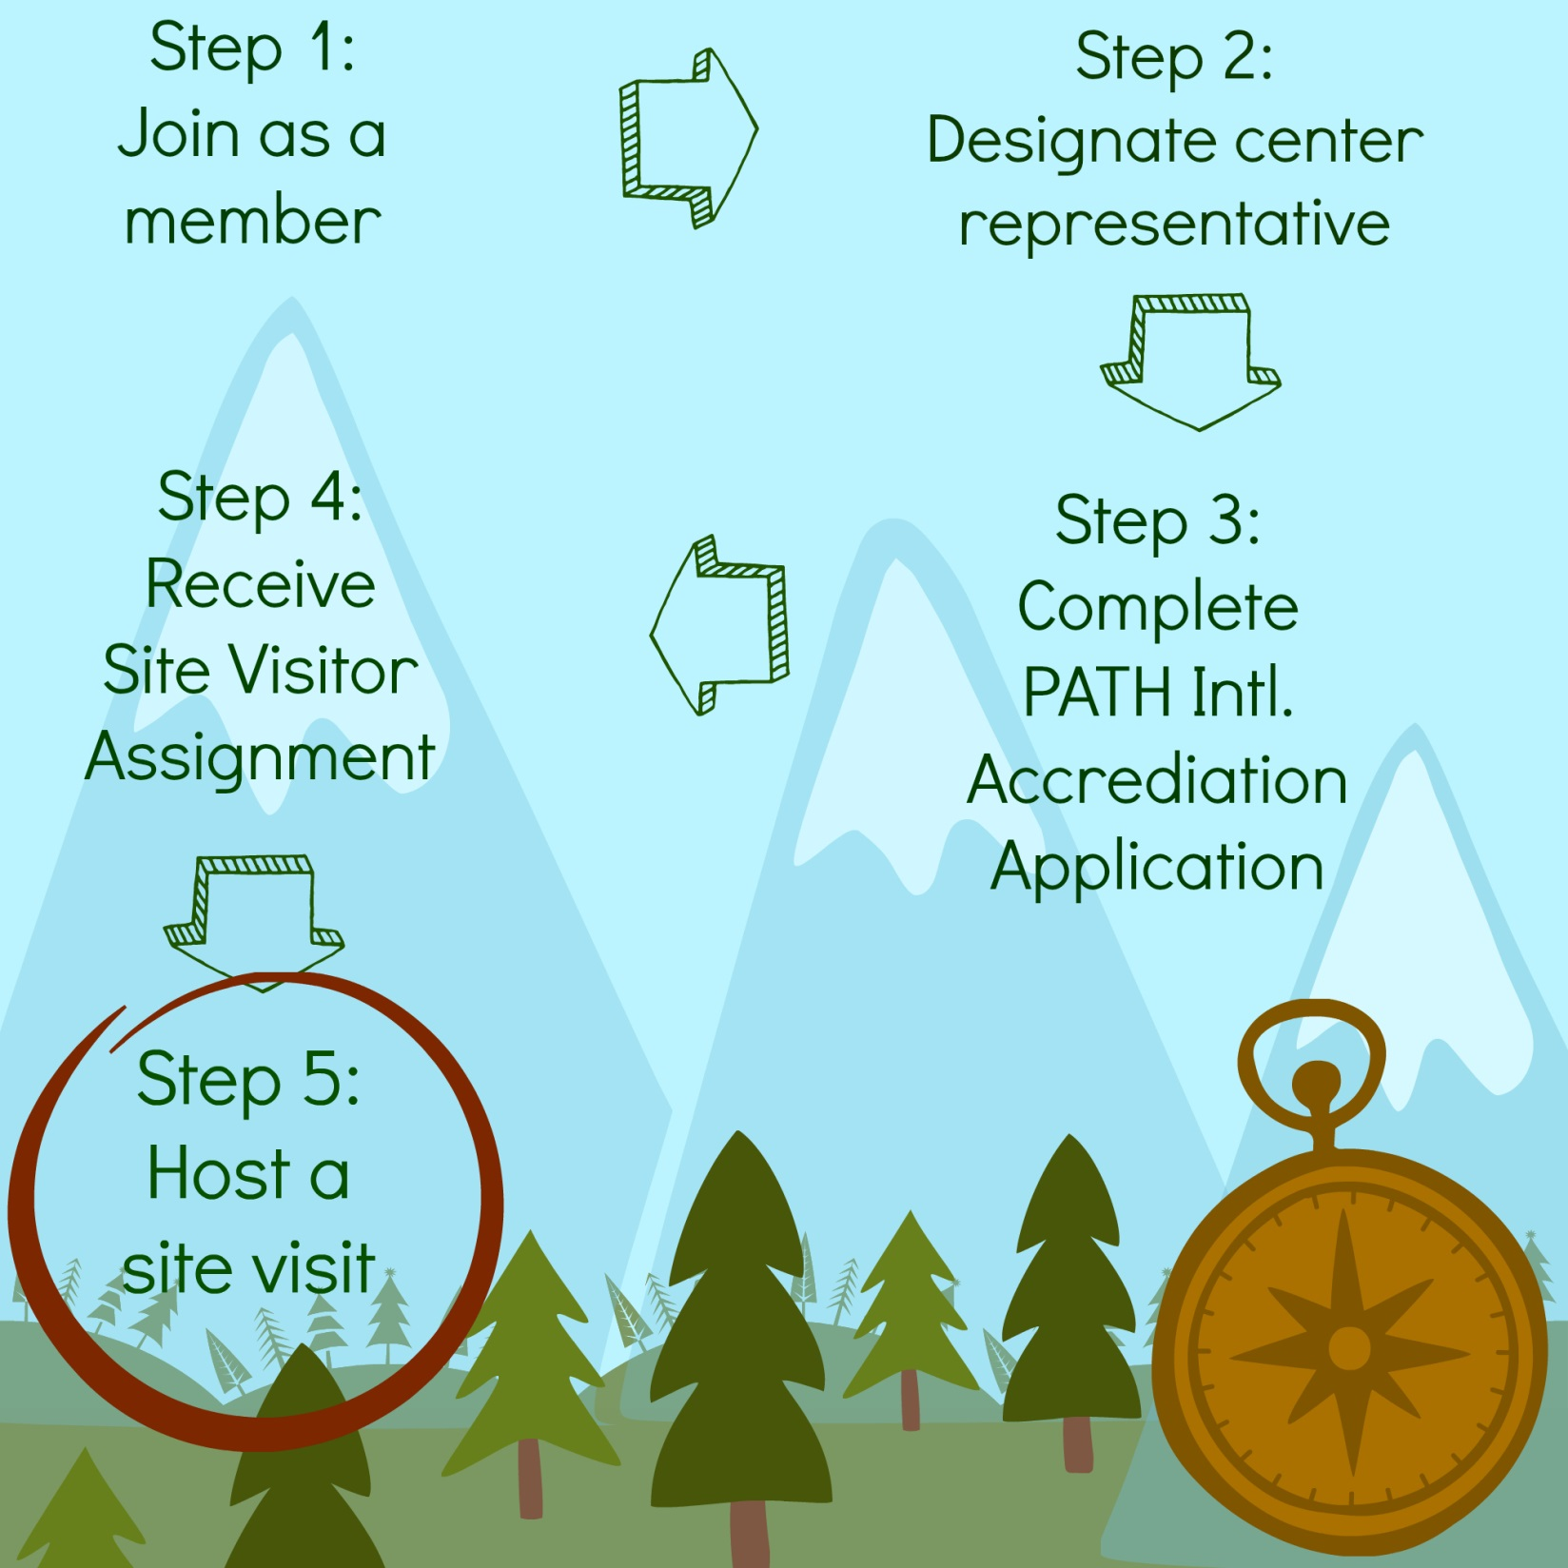

Slide 11
STEP 1
Join as a
PATH International
member center
Notes:
https://www.pathintl.org/path-intl-centers/path-intl-centers/start-path-intl-center#becomecenter

Slide 12
STEP 1
https://www.pathintl.org/path-intl-centers/path-intl-centers/start-path-intl-center#becomecenter
Notes:
https://www.pathintl.org/path-intl-centers/path-intl-centers/start-path-intl-center#becomecenter

Slide 13
Dues
Based on budget size
$0-$24,999
$390 per year

Slide 14
STEP 2
Designate
Center Representative
Notes:
Center Representative
Centers interested in participating in the PATH Intl. Premier Accredited Center process must designate a person from the center who will lead the center in the accreditation process and be the point of contact for all correspondence regarding accreditation. This person should also assist the center in preparing for the accreditation visit. This person is referred to as the center’s “center representative” and must meet the following requirements:
The PATH Intl. individual member chosen by the PATH Intl. center, to lead the accreditation process
Be the point of contact for all accreditation correspondence
Completes Center Self-Assessment Form
Center Representative informs PATH Intl. of any mandatory
standard compliance issues prior to the visit
Schedules one lesson per activity at all sites (if the center has
multiple sites) for the day of the visit
EFP can be a mock session
Ensures the center is ready for accreditation
Is present on the day of visit
Compiles an accreditation notebook (if desired)
It may be a good idea for the center to select an alternate center representative. The alternate center representative should be able to step in should there be an unexpected change due to an emergency on the day of the site visit. Any changes of the center representative on or before the day of the visit MUST be submitted to the PATH Intl. office in writing as soon as possible. Faxes and emails are acceptable.
*Must meet all the requirements of a center representative.

Slide 15

STEP 2
Notes:
Center Representative
Centers interested in participating in the PATH Intl. Premier Accredited Center process must designate a person from the center who will lead the center in the accreditation process and be the point of contact for all correspondence regarding accreditation. This person should also assist the center in preparing for the accreditation visit. This person is referred to as the center’s “center representative” and must meet the following requirements:
The PATH Intl. individual member chosen by the PATH Intl. center, to lead the accreditation process
Be the point of contact for all accreditation correspondence
Center Representative completes Standards Course
Completes Center Self-Assessment Form
Center Representative informs PATH Intl. of any mandatory
standard compliance issues prior to the visit
Schedules one lesson per activity at all sites (if the center has
multiple sites) for the day of the visit
EFP can be a mock session
Ensures the center is ready for accreditation
Is present on the day of visit
Compiles an accreditation notebook (if desired)
It may be a good idea for the center to select an alternate center representative. The alternate center representative should be able to step in should there be an unexpected change due to an emergency on the day of the site visit. Any changes of the center representative on or before the day of the visit MUST be submitted to the PATH Intl. office in writing as soon as possible. Faxes and emails are acceptable.
*Must meet all the requirements of a center representative.

Slide 16
STEP 3
Complete
PATH International
Accreditation
Application
Notes:
The application process can seem daunting at first, but PATH Intl. staff are available to help you in your journey to become a PAC! When you break the process down into a few steps, it can help programs create timelines and set themselves up for success.
Become a Member Center
One year as a PATH Intl. Center Member in good standing before applying for accreditation
Center Representative completes Standards Course
Application for accreditation must be sent within 90 days of completing Standards Course
Lead Visitor assigned
Lead Visitor and Center Representative schedule a mutually agreed upon date of visit

Slide 17
STEP 3
https://www.pathintl.org/images/pdf/centers/2018-path-intl-accreditation-and-reaccreditation-booklet.pdf

Slide 18
STEP 3

Slide 19
STEP 4
RECEIVE SITE VISITOR ASSIGNMENT

Slide 20
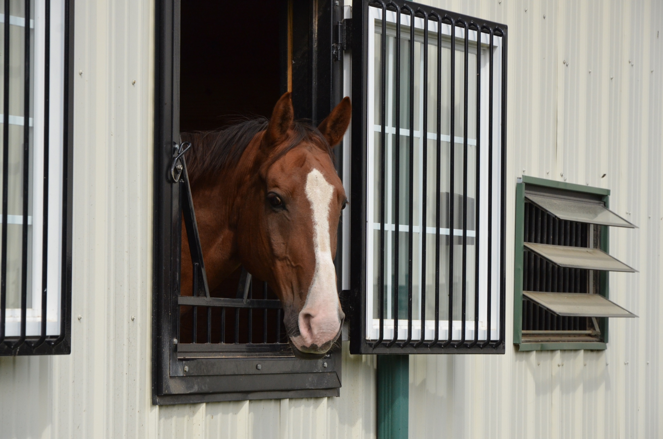
Site Visitors
Notes:
Site Visitors
Site visitors are volunteers who work on behalf of PATH Intl. and the premier accreditation program. They have completed a minimum of 20 hours of standards training to become visitors. They must participate in updates and continue to complete visits in order to retain their status. All site visitors are required to sign confidentiality statements and keep all information concerning the visit confidential. The visitors will sign releases or confidentiality policies as might be required by the center. Visitors have experience in the PATH Intl. center profession, often serving as the center representative of another PATH Intl. Premier Accredited Center.
There are two classifications of PATH Intl. site visitors: associate visitors and lead visitors. The lead visitor is defined as the visitor who is charged with the administrative responsibilities for arranging the process and coordination of the visit.
A site visit consists of two visitors; one is designated as the lead visitor, and the other is designated as the associate visitor.

Slide 21
STEP 5
HOST A SITE VISIT

Slide 22

STEP 5

Slide 23

What To Expect when scheduling a Site Visit
Scheduling
Interviews
Notes:
Lead visitor will contact the Center Rep to schedule a time and date:
Lead visitor completes the pre visit check list during the phone conversation
The visit must
A visit must occur within one year of the Center Representative successfully completing the Standards Course.
For Re-Accreditation it is has to occur before the 5th anniversary of the last visit.
A visit generally requires a full day. Lead visitor should ask about lunch and determine ahead of time if this will occur on site or if visitors will go off site
Visitors would typically like to begin the day with a tour of the center.
The center is responsible for the visiting day schedule and must be prepared for visitation of all activities and at all sites.
The visit should be completed in one day. When a site visit requires more than one day, the lead visitor submits the Site Visit Confirmation form to the PATH Intl. office for review. The responsibility of the extra expense is determined by the PATH Intl. CEO. The center will be notified by the PATH Intl. office if the additional travel expenses will be incurred by the center.

Slide 24
What To Expect during a
Site Visit
Interviews
Observations
Notes:
The visitors will:
Observe all areas of the center location(s) for compliance with standards
Interview staff, volunteers, and participants
Check that written policies match the implemented procedures observed or discussed
Observe one lesson for each activity/service the center offers
Confirm staff, volunteer, and participant paperwork complies with standards by observing randomly selected files
Lead visitor and Associate visitor usually meet before scoring
During the course of the visits, differences of opinion may arise regarding the interpretation of a standard. If the problem cannot be resolved, the lead visitor will make a determination and score the standard. The standard will be circled. The center representative and both visitors will write their opinions on the comment form for the Accreditation Sub-Committee to review. The visit will continue until all standards have been scored.

Slide 25

Be Organized
Notes:
On the day of the visit, be prepared for your site visitors. Have the day’s schedule ready and be sure that the center has referenced the current Standards for Certification & Accreditation as that is what your center will be scored on.
Remember that the manual is routinely updated so the current standards in effect, may not necessarily be the one you used when you took the Standards Course. The manual is subject to be updated annually, released and effective January 1st of each year.

Slide 26
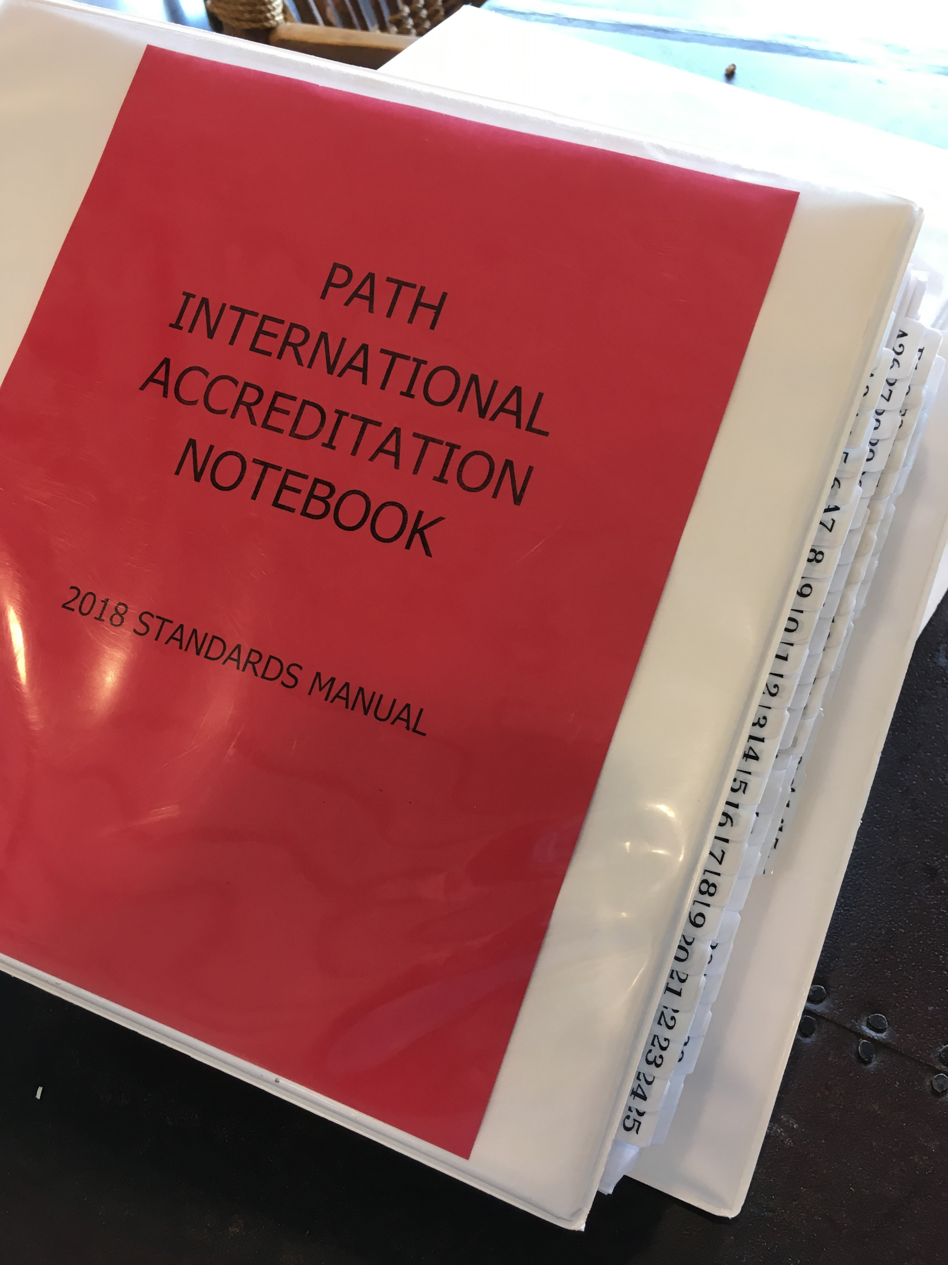
Take Note
Make a notebook
Involve your team
Notes:
An organized notebook is very helpful:
You can create your center an Accreditation Notebook to help in the process. A helpful resource for center representations and members of the program team is a special notebook or binder that features one standard per page. This format for the manual is available through the PATH Intl. website.
The center representative can highlight mandatory standards in one color; highlight standards that require something in writing in another color.
For each standard in the notebook, you and the program team can take note of the documentation that substantiates the standard.
Self-Assessment
The PATH Intl. Center Accreditation Self-Assessment form is a resource available to centers that can help to determine if they are ready to start the accreditation process. To become accredited, centers must be in 100% compliance with all PATH Intl. mandatory standards, have a passing score of 75% or higher in each category with an overall score of 80% or higher. The self-assessment allows centers to ensure that they are meeting the standards prior to the site visit. Center Representatives are not required to complete this form for Accreditation; however it is strongly encouraged to help you access your centers compliance with the standards.
We will take a closer look at scoring in a moment.

Slide 27
Setting Your Program Up For Success
Attention to Detail
Specialties
Policies & Procedures
Emergency Procedures
Update Information
Written Records
Notes:
After all of the time and effort spent in preparing your program for accreditation, be sure that you and all staff members of your center help set your program up for success. Explore these areas to encourage a productive, successful site visit.
Attention to Detail:
If the standard has subparts, all subparts must be in compliance in order to score a “yes” to the standard. Center did not address ALL subparts. The center also did not address both identifying the concerns in writing and providing written procedures to address those concerns.
Signatures and/or dates are missing. Take care when using double sided forms. Sometimes people forget to turn the form over to complete.
The equine emergency information was not placed in the equine first aid container.
Specialties:
Participants were not wearing ASTM/SEI helmets (documented by label in helmet or information printed out from ASTM-SEI website).
The arena was not clear of objects that might injure equines, participants and personnel.
Policies & Procedures:
First aid container did not have written documentation of maintenance.
Update Information:
Center did not update participant and volunteer information annually. Or follow their own policy on updates.
Emergency Procedures:
Centers (personnel, volunteers, and participants) did not rehearse emergency procedures.
No emergency information posted adjacent to the phone. Take care when using a cell phone as the emergency phone – information still needs to be posted adjacent to that phone, placed in a designated location, and with signal and charged battery.
Written Records:
No written contract for leasing or borrowing an equine.
Some of the persons and personnel listed on the organizational chart did not have a job description. All positions on the organizational chart must have written job descriptions for this standard.
Consent/non-consent for use of still and video photography not completed for all personnel, volunteers and participants.
Not all participants had a signed medical clearance form.
No written evidence of an introductory screening process for prospective equines.

Slide 28
Accreditation:
Scoring
Yes
No
DNA
Notes:
At the completion of the visit, the accreditation score form is completed by the lead visitor and a copy of the form is given to the center representative and a copy is retained by the lead visitor. Comments are written by both the lead visitor and the center representative for any standard receiving a “no” score. The score form and comment form are signed by the lead visitor, associate visitor and center representative.
Any ‘No’ scores must be documented on the Site Visit Comment Form by the Lead Visitor.
The Center Representative is encouraged to comment before moving on to next standard.

Slide 29
Do we only need to meet the mandatory standards?
100% ALL applicable Mandatory Standards
50% or better in Mounted, Interactive Vaulting, Equestrian Skills
Passing Score =
Minimum value in each category and 80% or better overall score
75% or better in Core Driving, MMH
Notes:
Maintaining elevated programming and passing accreditation means more than solely meeting mandatory standards.
In terms of passing a site visit, a minimum passing score means that 100% of all mandatory standards are passed along with:
-75% or better in Core, Driving, MMH
-50% or better in Mounted, Interactive Vaulting and Equestrian Skills
The overall score needs to be 80% or better to gain recognition as a Premier Accredited Center.

Slide 30
Accreditation:
Scoring
Appeals
Submission
Notes:
Any Mandatory Standards marked ‘No’ (non-compliant) must be documented and an Immediate Corrective Action Form completed before moving on to the next standard.
An appeal letter along with the Immediate Corrective Action Form must be postmarked to PATH within 5 working days.
Appeals process is covered more fully in the Accreditation & Reaccreditation Booklet.
Upon completion of the visit, the original score form and any supporting documentation is sealed in the presence of the center representative in a stamped envelope and mailed to the PATH Intl. office the same day for calculation. The responsibility to mail the score form rests with the lead visitor. If the original score form is lost, an unaltered copy may be used for scoring.

Slide 31

2016-17 Visit Data
Fiscal Year stats: July 2016-June 2017
53 Centers visited (Up from 35 visited in the previous year)
6 New, 47 Reaccredited
  52 Passed (23 passed with 100%)
  3 appealed
    3 passed on appeal
As of 12/31/2016 there are 272 PACs (881 Member Centers)
  In 2010: 236 PACs (573 Member Centers)
PATH Intl. Site Visitor Update
Notes:
31% in 2016
41% in 2010

Slide 32
Frequently Missed Standards
List of standards that were missed four or more times in the past year
Frequently missed from last year has decreased but this year there was an increased in missed MANDATORY standards:
2x MA3*-Stirrup and/or footwear policies(written)
8x A15 -media consent/non-consent
6x A16 -health history
7x A18 –AAI medical history
8x A18 -AAI medical history
5x ESK2- written participant initial evaluation
5x F21 -equine first aid kit
PATH Intl. Site Visitor Update

Slide 33
FYI: Electronic signatures!
As we move into the future with technology, many site visitors and center representatives have asked our policy on accepting electronic signatures for participant/volunteer paperwork.
Electronic signatures can be accepted so long as the center has a written policy regarding this and how they handle it (i.e- if power goes out/computer crashes, they must have a back-up)
PATH Intl. Site Visitor Update

Slide 34
Know Your Resources
Accreditation Booklet
  Accreditation process
  Appeals process
  Policies and Procedures
Accreditation Webinars
Link to Print One Standard Per Page for Accreditation Notebook/Binder
PATH Intl. Instructor Materials
Standards and Accreditation Community page
Instructor Continuing Education Webinars
Notes:
Thank you for joining us to learn more about PATH Intl. Standards for Certification and Accreditation. We wish you much success as you strive to offer safe and effective equine activities.
To access more resources as you pursue accreditation or instructor certification, visit PATH Intl.’s website at www.pathintl.org.

Slide 35
Know Your Resources
Shannon Middleton
  region8rep@pathintl.org
Joan Cutler
  jcutler@equest.org
  Joan.s.cutler@equest.org
Jeff Kelling
Director of Credentialing and Education
Ext. 112
Notes:
Thank you for joining us to learn more about PATH Intl. Standards for Certification and Accreditation. We wish you much success as you strive to offer safe and effective equine activities.
To access more resources as you pursue accreditation or instructor certification, visit PATH Intl.’s website at www.pathintl.org.

Slide 36
More than just Surviving a
PATH International Site Visit
YOU are going to OWN IT!!

Slide 37



Slide 38

© 2018 PATH Intl. All rights reserved. Professional Association of Therapeutic Horsemanship®, PATH Intl.®, PATH Intl. Ensuring excellence and changing lives through equine-assisted activities and therapies®, and the PATH Intl. logo are PATH Intl. registered trademarks and may not be used without PATH Intl. permission. NARHA®, EFMHA® and the NARHA logo are registered trademarks and may not be used without PATH Intl. permission. Use of ® indicates trademarks in the U.S. and elsewhere.

